Slide 1
Probability
Rule of multiplication

Slide 2
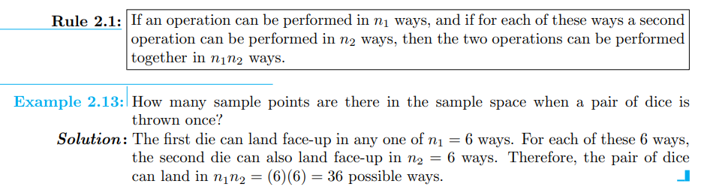
Counting Sample Points
In many cases, we shall be able to solve a probability problem by counting the number of points in the sample space without actually listing each element.

Slide 3
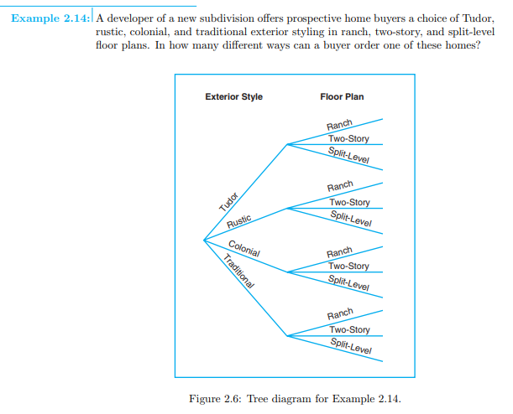
olution: Since n1 = 4 and n2 = 3, a buyer must choose from n1n2 = (4)(3) = 12 possible homes.

Slide 4
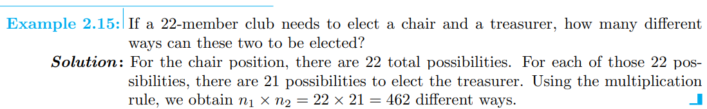
The multiplication rule, Rule 2.1 may be extended to cover any number of operations. Suppose, for instance, that a customer wishes to buy a new cell phone and can choose from n1 = 5 brands, n2 = 5 sets of capability, and n3 = 4 colors. These three classifications result in n1n2n3 = (5)(5)(4) = 100 different ways for a customer to order one of these phones. The generalized multiplication rule covering k operations is stated in the following

Slide 5
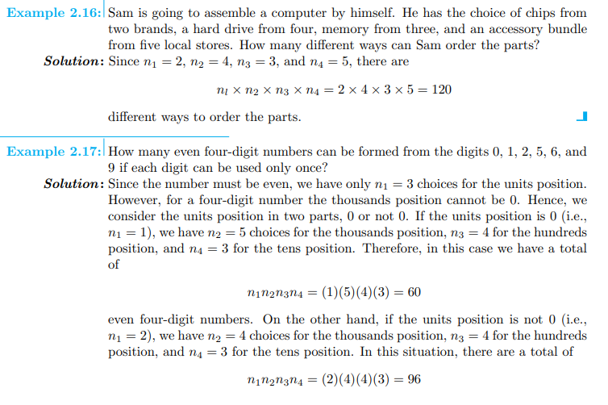

Slide 6
even four-digit numbers. Since the above two cases are mutually exclusive, the total number of even four-digit numbers can be calculated as 60 + 96 = 156.

